Slide 1



Advanced Developer Workflows & Mini-Project
www.zarantech.com
© Copyright 2026, ZaranTech LLC. All rights reserved.

Slide 2


Disclaimer
This presentation, including examples, images, and references are provided for informational purposes only.
Complying with all applicable copyrights laws is the responsibility of the user.
Without limiting the rights under copyright, no part of this document may be reproduced, stored or introduced into a retrieval system, or transmitted in any form or by any means.
Credits shall be given to the images taken from the open-source and cannot be used for promotional activities.
© Copyright 2026, ZaranTech LLC. All rights reserved.

Slide 3

Agenda
Master system planning and design using Claude as your thought partner.
Create technical specifications and generate sequence diagrams from text descriptions.
Integrate Claude into daily tooling for version control and infrastructure management.
Complete a capstone project demonstrating robust prompt design and API integration.
© Copyright 2026, ZaranTech LLC. All rights reserved.

Slide 4
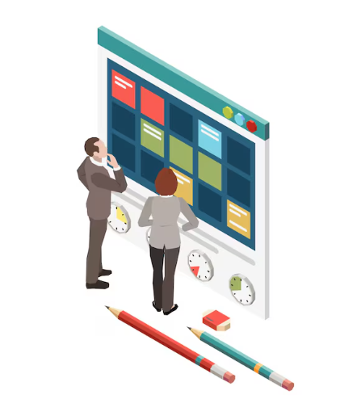
Exercises in This Module
Exercise 13: Turn a feature brief into a spec and tickets. 18 minutes.
Exercise 14: Generate and correct a configuration file. 12 minutes.
Exercise 15: Build the summariser service. 35 minutes, across three videos.
Exercise 15 is the capstone build itself, not a rehearsal for it.
© Copyright 2026, ZaranTech LLC. All rights reserved.

Slide 5
Planning and Design
Treat Claude as a pair architect to brainstorm scalable system architecture.
Describe business logic and let Claude propose optimal microservices design patterns.
Validate database schema decisions by asking Claude for bottleneck analysis.
Refine architectural drafts through an iterative dialogue to ensure best practices.
© Copyright 2026, ZaranTech LLC. All rights reserved.

Slide 6

Writing Technical Specifications
Transform project ideas into comprehensive technical specification documents within minutes.
Outline endpoints and let Claude generate standard OpenAPI specification formats easily.
Define system constraints to receive non-functional requirements for your application.
Standardize team documentation formats by applying custom prompt templates during generation.
© Copyright 2026, ZaranTech LLC. All rights reserved.

Slide 7
Generating Sequence Diagrams
Describe system interactions in text to generate accurate Mermaid sequence diagrams.
Visualize asynchronous messaging workflows between microservices using simple text prompts.
Update existing diagrams quickly by instructing Claude to add new components.
Export generated diagram code into your markdown documentation for seamless sharing.
© Copyright 2026, ZaranTech LLC. All rights reserved.

Slide 8
Creating Task Breakdowns
Input technical specs to receive structured, logical development task breakdowns.
Identify critical path dependencies early by asking Claude to sequence steps.
Break monolithic features into smaller tickets suitable for agile sprint cycles.
Estimate development complexity for each task using previously provided historical context.
© Copyright 2026, ZaranTech LLC. All rights reserved.

Slide 9

Building Agile Backlogs
Convert high-level business requirements directly into detailed product backlog items.
Generate clear user stories formatted with standard acceptance criteria for developers.
Prioritize your backlog logically by asking Claude to analyze business metrics.
Ensure comprehensive feature coverage by having Claude identify missing edge cases.
© Copyright 2026, ZaranTech LLC. All rights reserved.

Slide 10
Defining Sprint Tasks
Translate accepted user stories into technical tasks for immediate sprint execution.
Define exact input and output parameters for every backend API task.
Draft initial unit test scenarios corresponding to each individual sprint task.
Allocate appropriate story points based on technical complexity assessed by Claude.
© Copyright 2026, ZaranTech LLC. All rights reserved.

Slide 11
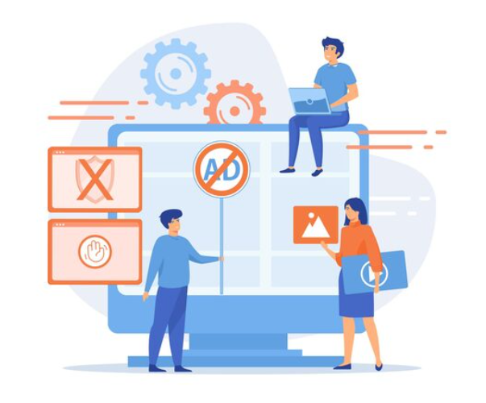
Integrations and Tooling
Enhance daily productivity by integrating Claude directly within your code editors.
Leverage IDE extensions for contextual code suggestions without switching application windows.
Highlight complex code blocks and ask Claude to explain underlying logic.
Generate boilerplate code and test structures directly inside your development environment.
© Copyright 2026, ZaranTech LLC. All rights reserved.

Slide 12

Streamlining Git Workflows
Summarize complex code changes automatically to generate meaningful commit messages.
Draft pull request descriptions explaining the technical rationale behind recent changes.
Analyze code diffs quickly to identify potential logic conflicts before merging.
Standardize your team commit history by applying strict format rules.
© Copyright 2026, ZaranTech LLC. All rights reserved.

Slide 13

CI/CD Integration for Documentation
Call the API from a non-interactive script in the pipeline. CI has no terminal to prompt.
Generate dynamic release notes automatically based on merged pull requests.
Ensure updated functions contain accurate docstrings before reaching production servers.
Maintain synchronized architectural documentation automatically when structural changes are merged.
© Copyright 2026, ZaranTech LLC. All rights reserved.

Slide 14
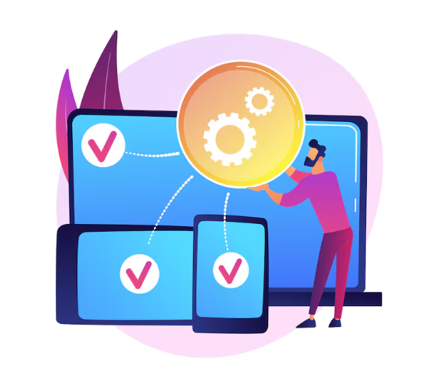
CI/CD Automated Checks
Implement intelligent static analysis checks to review code style during execution.
Utilize Claude to flag potential security vulnerabilities before staging deployments.
Suggest automated remediation steps for failed builds directly in pipeline logs.
Reduce manual code review time by prioritizing critical issues highlighted.
© Copyright 2026, ZaranTech LLC. All rights reserved.

Slide 15
Generating Migration Scripts
Describe schema changes to generate database migration scripts automatically using Claude.
Validate generated migration code against best practices to prevent data loss.
Create complex data transformation logic across formats without manual coding efforts.
Draft safe rollback scripts simultaneously to ensure zero downtime during failures.
© Copyright 2026, ZaranTech LLC. All rights reserved.

Slide 16
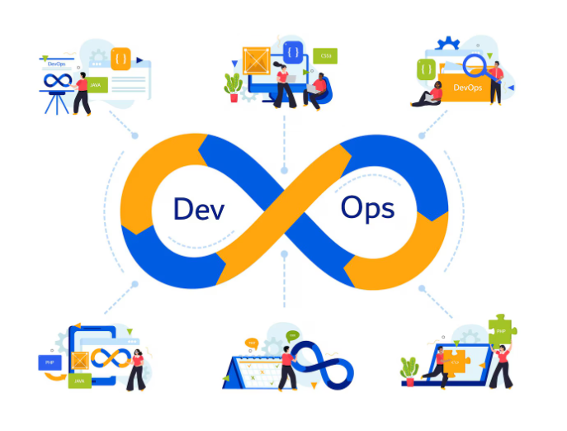
DevOps and Infrastructure as Code
Formulate robust Terraform configurations from simple text descriptions of cloud architecture.
Generate Dockerfiles tailored specifically to your application dependencies and runtime requirements.
Create resilient Kubernetes deployment manifests without consulting extensive external reference documentation.
Optimize cloud infrastructure by asking Claude to identify potential cost-saving configurations.
© Copyright 2026, ZaranTech LLC. All rights reserved.

Slide 17

Capstone Mini-Project Overview
Build one small service: a summarise endpoint and a health endpoint. That is the whole scope.
Experience a complete development lifecycle utilizing Claude as your coding assistant.
Your brief was issued at the end of Module 4. A skeleton project is provided.
You are graded on prompt design and failure handling, not on feature count.
© Copyright 2026, ZaranTech LLC. All rights reserved.

Slide 18
Capstone Phase 1 - Prompt Design
Craft robust system prompts to establish consistent personas and boundaries.
Utilize zero-shot and few-shot prompting to guide accurate code generation.
Implement context window management strategies to maintain state across complex tasks.
Iteratively refine instructional prompts to reduce hallucination and ensure predictable outputs.
© Copyright 2026, ZaranTech LLC. All rights reserved.

Slide 19
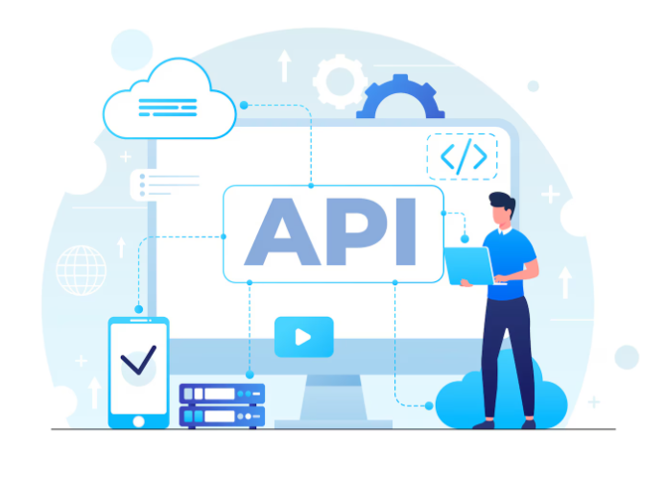
Capstone Phase 2 - API Integration
Connect your application backend securely to the required external programming interfaces.
Handle rate limits and connection timeouts gracefully using exponential backoff logic.
Securely manage authentication tokens and credentials using environment variable best practices.
Process unstructured textual responses into standardized JSON formats for predictable rendering.
© Copyright 2026, ZaranTech LLC. All rights reserved.

Slide 20
Capstone Phase 3 - Testing the Application
Prompt Claude to generate comprehensive unit tests covering all business logic.
Design mocked API responses to simulate network errors and edge cases.
Validate end-to-end user workflows using automated integration tests generated by AI.
Measure code coverage automatically and address missing test cases via prompts.
© Copyright 2026, ZaranTech LLC. All rights reserved.

Slide 21

Evaluation Criteria - Correctness & Robustness
The service runs, both endpoints respond, and invalid input returns a clear error.
Ensure generated code compiles successfully and executes without unexpected runtime exceptions.
Validate the system handles erroneous inputs securely without exposing sensitive data.
Missing key, empty input, oversized payload and upstream failure each fail cleanly.
© Copyright 2026, ZaranTech LLC. All rights reserved.

Slide 22
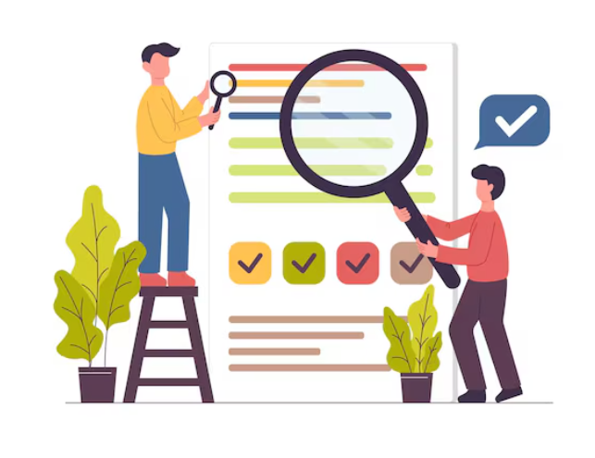
Evaluation Criteria - Clarity
Ensure code remains readable, modular, and follows standard language styling conventions.
Maintain clear inline documentation explaining complex logic and specific design choices.
Structure your project directories logically to enable intuitive navigation for developers.
Provide an extensive readme file outlining complete setup and deployment instructions.
© Copyright 2026, ZaranTech LLC. All rights reserved.

Slide 23
How the Capstone Is Marked
Prompt design, 25 points. A real template: role, task, tagged input, output constraints.
Robustness, 25 points. Four named failure paths each return a clean, specific error.
Correctness 15, tests 15, structure and responsible practice 10.
Reflection, 10 points. What you corrected, and which prompt change mattered most.
Full thresholds are in the capstone brief. Read them before you start building.
© Copyright 2026, ZaranTech LLC. All rights reserved.

Slide 24

Evaluation Criteria - Responsible Practices
Demonstrate safe prompt engineering by sanitizing user inputs before API calls.
Implement ethical safeguards preventing applications from generating harmful or biased content.
Securely protect user privacy by anonymizing personal data before cloud processing.
Document transparent AI usage guidelines clearly within your final project repository.
© Copyright 2026, ZaranTech LLC. All rights reserved.

Slide 25

Key Takeaways
Leveraged Claude as a collaborative pair architect to plan complex systems.
Integrated AI seamlessly into daily tooling spanning code editors and pipelines.
Automated infrastructure tasks like generating migration scripts and terraform deployment files.
Validated practical skills by deploying a robust, fully tested capstone application.
© Copyright 2026, ZaranTech LLC. All rights reserved.

Slide 26
Thank You
For more informative Videos, Subscribe to our YouTube Channel
www.zarantech.com
© Copyright 2026, ZaranTech LLC. All rights reserved.

